Slide 1

Health Assistant Using Machine Learning
HALDIA INSTITUTE OF TECHNOLOGY
Dept : INFORMATION TECHNOLOGY
Submitted To :- Mr. Debasish Sahoo
Submitted By :--
Name | Roll No | Email
Subhadip Dey | 10300223170 | deysubhadip66@gmail.com
Srijani Dinda | 10300223169 | srijanidinda64@gmail.com
Sathi Pramanik | 10300223137 | 18sathipramanik@gmail.com

Slide 2
Problem Statement
Doctors and healthcare staff are required to make quick and critical decisions based on multiple patient parameters such as age, vitals, medical history, and lifestyle factors.
Manual analysis of patient records is time-consuming and may not always provide accurate or timely insights, especially when dealing with large volumes of data.
Predicting disease conditions, recovery duration, treatment cost, and readmission risk becomes challenging due to the complexity and size of healthcare datasets.
The lack of automated data analysis can lead to delayed diagnosis, inefficient treatment planning, and increased workload for healthcare professionals.

Slide 3
Project Objectives
1
2
3
Disease Prediction
Risk Assessment
Personalized Guidance
Predict possible diseases using patient health parameters and vital signs through machine learning algorithms
Estimate individual health risk levels and potential recovery duration based on predicted conditions
Provide personalized, educational health suggestions through an intelligent assistant system

Slide 4
Machine Learning Methodology
Training Approach
Feature Analysis
Disease Clustering
Prediction Output
Feature-based analysis using patient vitals, medical history, and demographic information
Confidence-oriented prediction results with statistical reliability metrics
Supervised machine learning models trained on validated hospital patient datasets
Advanced disease clustering with probability-based ranking algorithms

Slide 5
Dataset Overview
Total Records: 10,000 patient records, representing a large and diverse sample suitable for reliable statistical analysis and machine learning model training.
Total Attributes: 28 features covering patient demographics, physical measurements, health indicators, hospital operations, financial information, and medical outcomes.
Data Types: A combination of numerical data (such as age, vital signs, hospital stay duration, and treatment cost) and categorical data (such as gender, disease type, lifestyle habits, insurance status, and treatment outcomes).
Data Nature: The dataset simulates a real-world hospital environment, reflecting practical healthcare scenarios and patient variability.
Use Cases: Designed for healthcare analytics, including disease prediction, treatment cost estimation, patient outcome analysis, and hospital readmission risk assessment using machine learning techniques.

Slide 6







Dataset Attributes
Patient Demographic Details
Patient_ID , Patient_Name , Age , Gender , City
Physical Details
Height_cm , Weight_kg
Health Metrics
Pulse_Rate , Oxygen_Level ,BP ,
Sugar ,Chol
Lifestyle & Risk Factors
Smoke, Alcohol , Stress_Level ,
Chronic_Disease
Hospital & Treatment Details
Doctor_Specialization, Appointment_Type, Admit_Type, ICU_Required, Days, Visits
Medical Outcomes
Disease , Outcome, Readmitted, Status
Financial Information
Cost , Insurance

Slide 7
Feature Selection
To improve model accuracy and reduce complexity, the most relevant health-related features were selected based on correlation analysis and domain knowledge.
Selected Features
Age – Influences disease risk and treatment cost
Height (cm) – Used for physical assessment and BMI calculation
Weight (kg) – Indicates body condition and health risk
Blood Pressure (BP) – Key indicator of cardiovascular health
Sugar Level – Important for diabetes and metabolic conditions
Cholesterol Level – Associated with heart disease risk
Days in Hospital – Reflects severity of illness and treatment duration
Number of Visits – Indicates frequency of medical attention required
Treatment Cost – Primary target variable for prediction

Slide 8


Machine Learning Models Used
Classification Models
Random Forest Classifier
Ensemble-based model using multiple decision trees
Handles complex relationships and reduces overfitting
Provides high accuracy and feature importance
K-Nearest Neighbors (KNN)
Distance-based algorithm
Classifies patients based on similarity to nearby data points
Useful for pattern recognition in patient health profiles
Logistic Regression
Simple and interpretable linear classification model
Effective for binary outcomes such as Recovered / Not Recovered
Works well with well-selected features
Regression Model
Random Forest Regressor
Predicts the number of days required for patient recovery
Captures non-linear relationships between health parameters
Robust to noise and performs well on real-world healthcare data

Slide 9
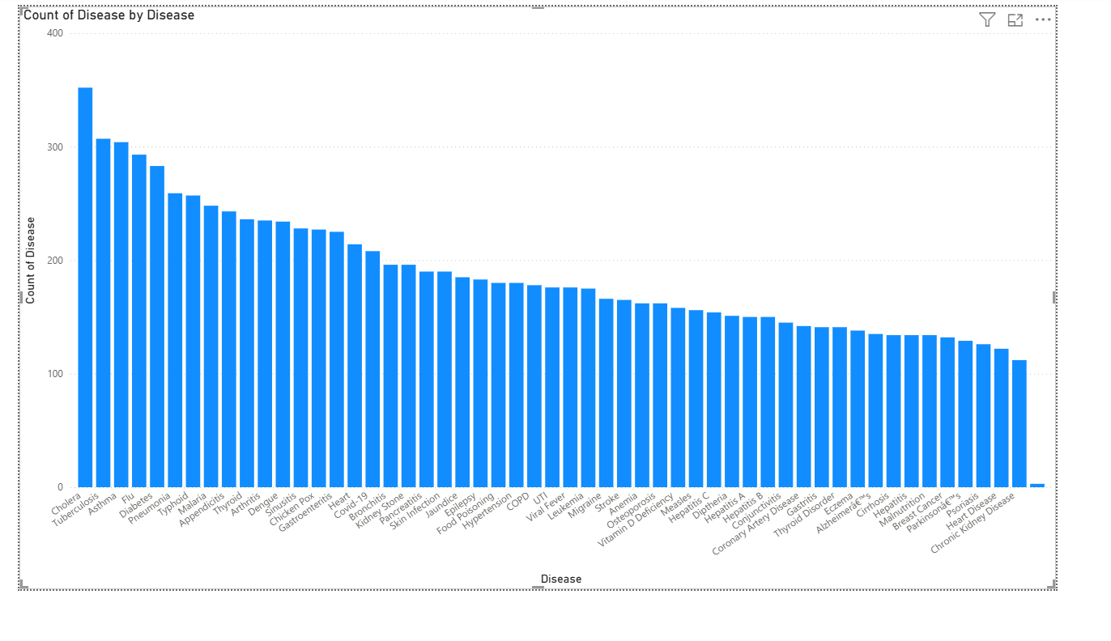
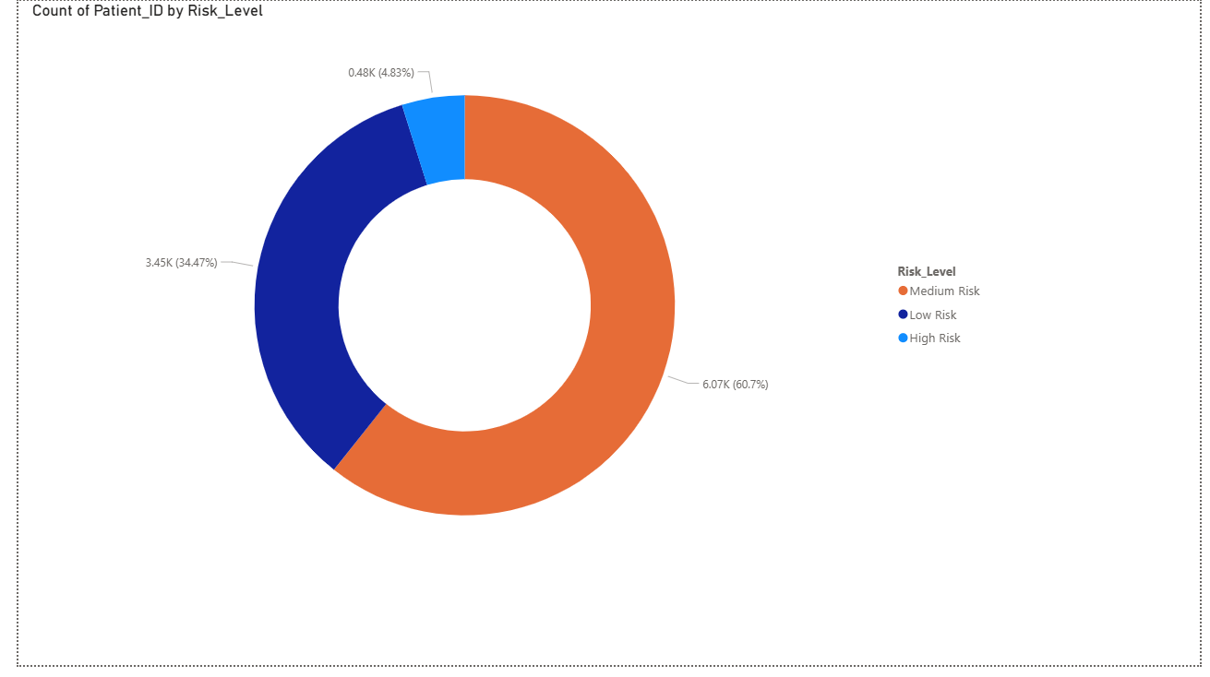
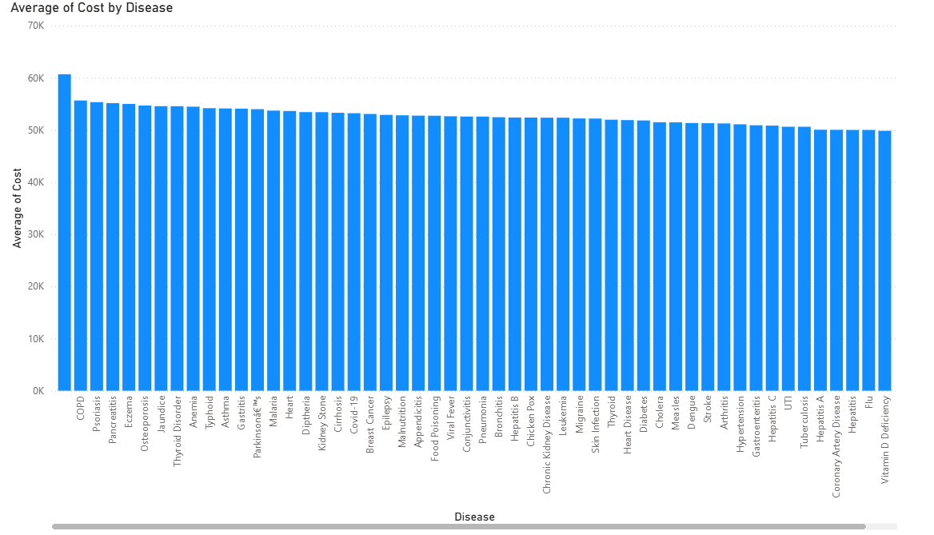
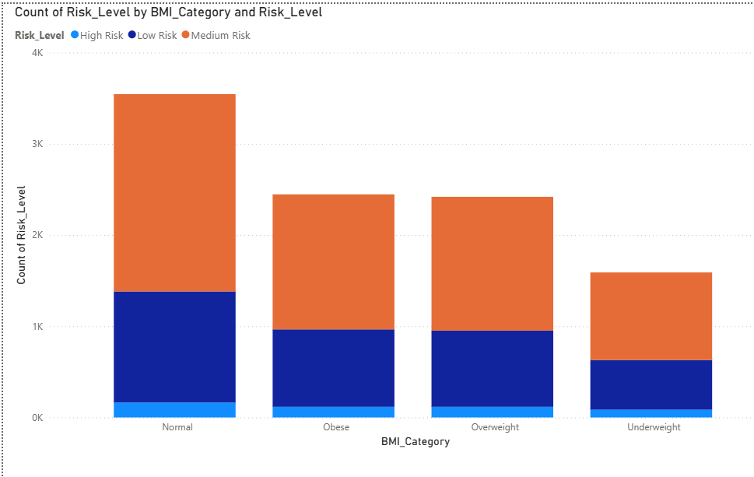
Data Analysis Report

Slide 10
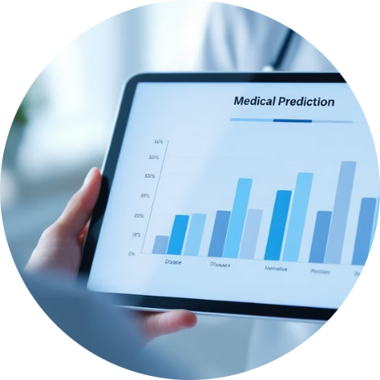
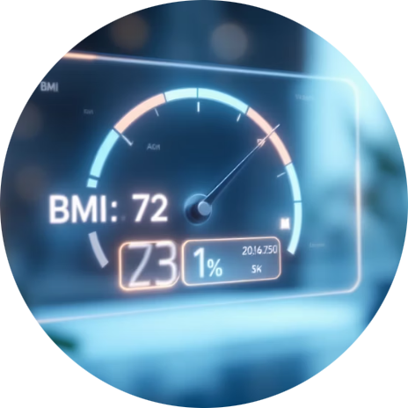
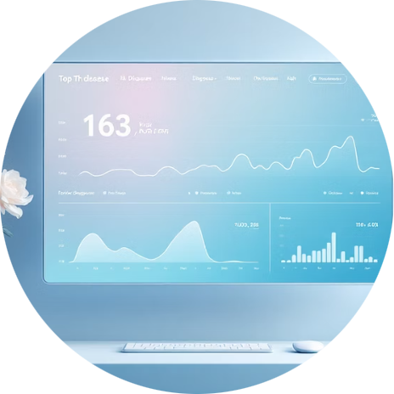

Core Functionalities
Disease Prediction
BMI & Risk Classification
Top Disease Display
Health Query Assistance
Generates disease predictions with confidence scores and probability rankings
Displays top three probable diseases ranked by statistical likelihood
Calculates body mass index and classifies individual health risk levels
Provides context-aware responses to user health questions and concerns

Slide 11

Technology Stack
Frontend
React.js framework for responsive, interactive user interface design
Backend
Python with Flask framework providing RESTful API services
Machine Learning
Scikit-learn library for model development and prediction algorithms
Data Processing
Pandas and NumPy libraries for efficient data manipulation and analysis
Health Assistant
Local large language model (LLM) deployed using Ollama platform

Slide 12




Results and Advantages
Reliable Prediction
Health Awareness
Delivers accurate disease prediction based on comprehensive patient data analysis
Improves patient health awareness and understanding of potential risk factors
User-Friendly Interface
Privacy-Focused
Provides intuitive and responsive web interface accessible across devices
Ensures intelligent assistance while maintaining strict patient data privacy standards

Slide 13

Conclusion
The ML-Based Health Prediction and Assistance System demonstrates the practical application of machine learning in healthcare, providing accessible, data-driven health insights while maintaining user privacy and system reliability.
This project represents a step forward in making preliminary health assessment more accessible and empowering individuals with intelligent, personalized health information.

Slide 14
THANK YOU

